Slide 1
Presentation brief for MCT’s
Title of presentation | Explore compute and storage options for data engineering workloads
Presentation\Lab length | Presentation: 20 - 25 minutes Lab: 50 – 60 minutes
Audience | Data Engineers, Data Scientists, Data Professionals, Data Architects, BI Professionals, Developers
Purpose | Introduce core compute technologies used for data engineering in Azure Understand the role that a data lake plays in providing a storage layer How to organize your data in a data lake to optimize for exploration, streaming and batch workloads
(think) Student key takeaways | The student should understand the compute options for data engineers in Azure The student should understand the role of a data lake plays in data engineering The student should be aware that this module is a broad introduction. They will not necessarily understand all of the content at this stage and topics are covered in more depth in later modules
(feel) Student desired mindset | The student may feel that organizing a data lake is not an important task The student may feel confusion about the different Spark options that are available and which one to use The student may feel they are not familiar with Python and may need help understanding the code in the lab
(do) Student outcomes | The student should be able to articulate a one sentence description of each data platform technology The student should be able to difference between bronze, silver and gold data lake architectures The students should be able to understand the spark code in the lab and what it is doing
More information | For MCT course feedback, visit the Microsoft Official Courseware forum
Notes:
Instructor notes and guidance
This slide is for MCT use only, outlining the aims and objectives of this module.

Slide 2
DP-203T00: Explore compute and storage options for data engineering workloads
Notes:
Instructor notes and guidance
Introduce to the students that this module explores the range of compute and storage options that are used for data engineering on Azure.
At this stage they are only being introduced to the technologies at a high level to set the students expectations of the technologies that will be covered in the course. For each slide, you should only provide the headline capabilities of each of the technologies and communicate to the student that they will explore these capabilities in depth as they progress through the course. This will be the only module where we cover Azure Data Lake store in depth, and it is the reason why the lab focuses so much on how the data lake can be optimized while using the compute technologies.
In the lab, we take to opportunity to explore the interaction of two compute technologies; Azure Databricks and Azure Synapse Analytics Spark pools, but not in any real depth and this is by design. The focus of the lab is how these compute technologies interact with the primary data storage option for analytical workloads in Azure; Azure Data Lake storage.

Slide 3
Agenda
Lesson 01 – Introduction to Azure Synapse Analytics
Lesson 02 – Describe Azure Databricks
Lesson 03 – Introduction to Azure Data Lake storage
Lesson 04 – Describe Delta Lake architecture
Lesson 05 – Work with data streams by using Azure Stream Analytics
Notes:
Instructor notes and guidance
This space has been left deliberately blank.

Slide 4
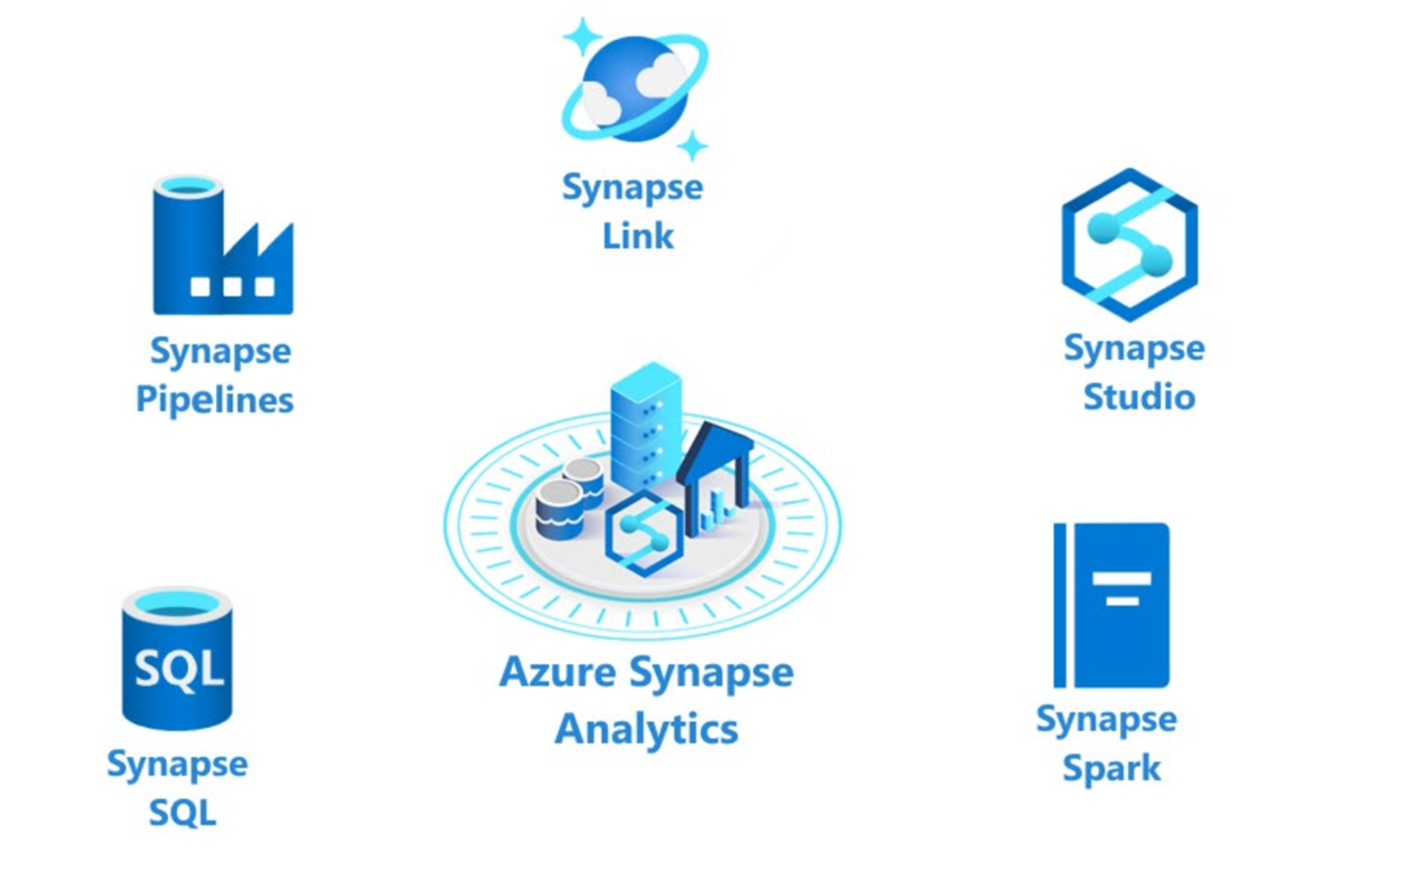
Introduction to Azure Synapse Analytics
Notes:
Talking points
The following components are available in Azure Synapse Analytics:
- Analytics capabilities are offered through Synapse SQL through either dedicated SQL pools or serverless SQL pools.
- Apache Spark pool with full support for Scala, Python, SparkSQL, and C# with Synapse Spark
- Data Integration & Orchestration to integrate your data and operationalize all of your code development with Synapse Pipelines
- Perform operational analytics with near real-time hybrid transactional and analytical processing with Azure Synapse Link.
- Use Synapse Studio to access all of these capabilities through a single Web UI
Instructor notes and guidance
Only provide the headlines of the capability on this slide, tell the students that coverage of Azure Synapse Analytics is provided in the following modules
Module 4: Run interactive queries using serverless SQL pools
Module 7: Ingest and load Data into the Data Warehouse
Module 8: Transform Data with Azure Data Factory or Azure Synapse Pipelines
Module 9: Integrate Data from Notebooks with Azure Data Factory or Azure Synapse Pipelines
Module 10: Optimize Query Performance with Dedicated SQL Pools in Azure Synapse
Module 11: Analyze and Optimize Data Warehouse Storage
Module 12: Support Hybrid Transactional Analytical Processing (HTAP) with Azure Synapse Link
Module 13: End-to-end security with Azure Synapse Analytics
Module 16: Build reports using Power BI integration with Azure Synapse Analytics
Module 17: Perform Integrated Machine Learning Processes in Azure Synapse Analytics
Call out to the students, that in the lab for this module, they will experience working with Apache Spark pools in Azure Synapse Analytics and how it works with a data lake, this is only one aspect of Azure Synapse analytics, and they will cover more in later modules
Recommended reading for this slide
Introduction to Azure Synapse Analytics - Learn | Microsoft Docs
Survey the Components of Azure Synapse Analytics - Learn | Microsoft Docs

Slide 5
What is Azure Databricks
Apache Spark-based analytics platform:
Simplifies the provisioning and collaboration of Apache Spark-based analytical solutions dealing with batch and streaming data
Comprehensive Spark library support:
Support includes SQL, DataFrames, MLlib, Hyperspace and MSSparkUtil
Enterprise Security:
Utilizes the security capabilities of Azure
Integration with other Cloud Services:
Can integrate with a variety of Azure data platform services and Power BI
Notes:
Talking points
Azure Databricks is a managed Spark as a Service propriety solution that provides an end-to-end data engineering/data science platform as a solution. Azure Databricks is of interest for Data Engineers and Data Scientists, working on big data projects daily because it provides the whole platform in which you have the ability to create and manage the big data/data science pipelines/projects all on 1 platform.
It is likely that you may have students that use Azure Databricks already. One of the commons questions that is asked by customers is whether Azure Databricks can work with Azure Synapse Analytics. The answer is yes. There are example of customers who use Azure Databricks for the Spark capabilities, and Azure Synapse Analytics for the data warehousing, integration and visualization capabilities successfully.
Instructor notes and guidance
Only provide the headlines of the capability on this slide, tell the students that coverage of Azure Synapse Analytics is provided in the following modules
Module 6: Data exploration and transformation in Azure Databricks
Module 15: Create a Stream Processing Solution with Event Hubs and Azure Databricks
Related modules include
Module 9: Integrate Data from Notebooks with Azure Data Factory or Azure Synapse Pipelines
Call out to the students, that in the lab for this module, they will experience working with Azure Databricks and how it works with a data lake
Recommended reading for this slide
Describe Azure Databricks - Learn | Microsoft Docs
Spark architecture fundamentals - Learn | Microsoft Docs

Slide 6
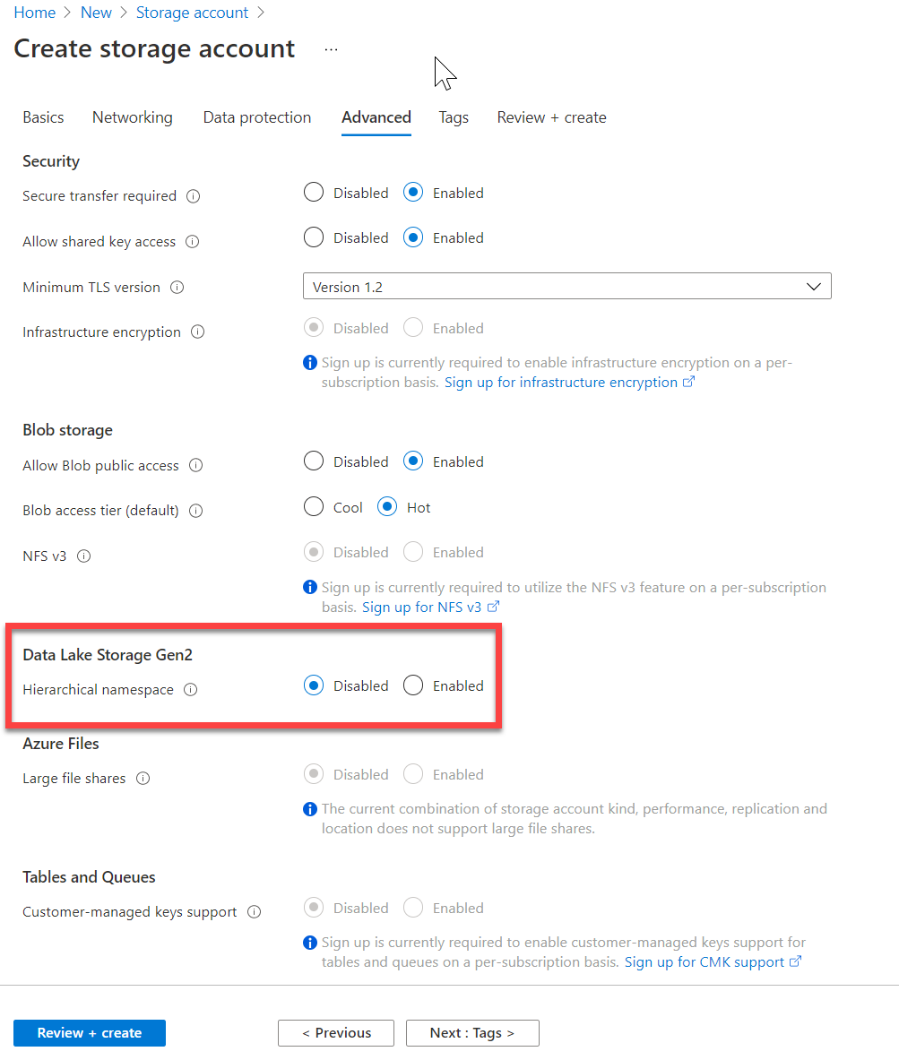
Introduction to Azure Data Lake storage
Hadoop compatible
Security
Performance
Redundancy
Notes:
Talking points
The first point of “Hadoop Access” is a key differentiator for using Azure Data Lake Storage Gen2 (ADLSG2) over Blob storage. Coupled with the security model that provides very granular permissions, this makes ADLSG2 a compelling data storage tier for a range of Azure data platform technologies including Azure Synapse and Azure Databricks. The ability to perform big data analytics is critical and the performance of ADLSG2 helps with that performance. All of this comes with the Geo redundancy capability to ensure that the data is safe.
Instructor notes and guidance
This will be the only module where we cover Azure Data Lake store in depth, and it is the reason why the lab focuses so much on how the data lake can be optimized while using the compute technologies. As a result, you can spend some time on the list in the slide, and ultimately state to the students that all this is achieved with a single selection of a radio button when you create a storage account.
Recommended reading for this slide
Introduction to Azure Data Lake storage - Learn | Microsoft Docs

Slide 7
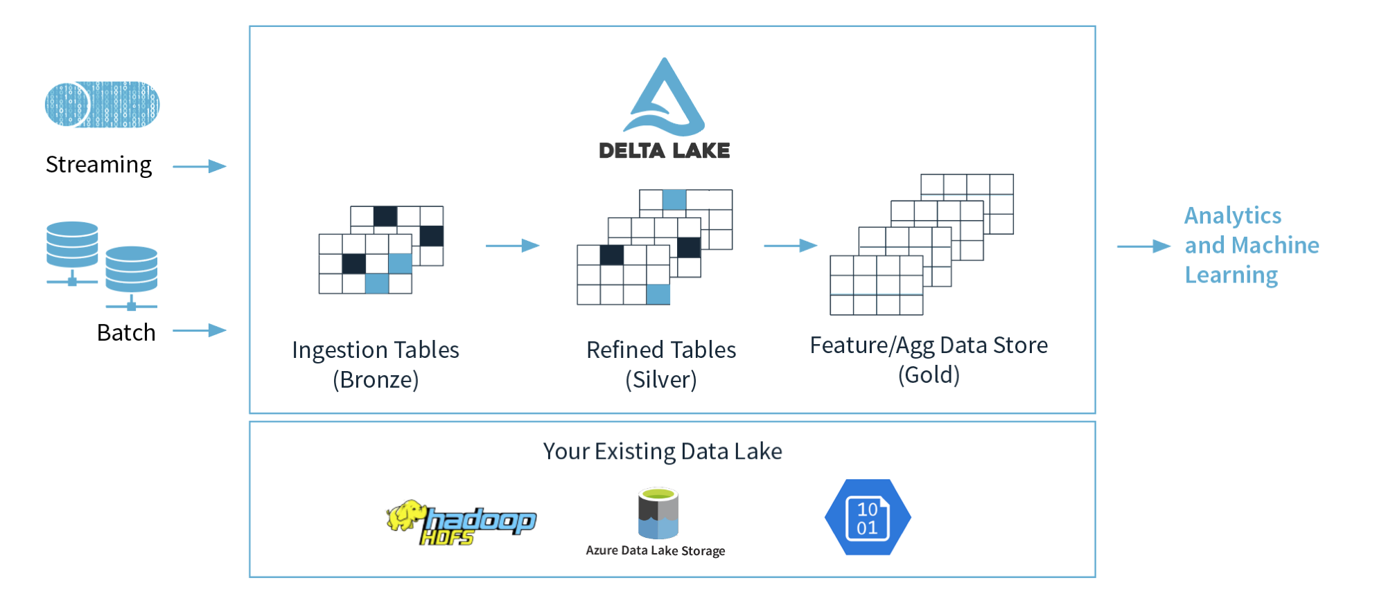
Describe a Delta Lake architecture
Notes:
Talking points
Delta Lake is an open-source storage layer that brings ACID (atomicity, consistency, isolation, and durability) transactions to Apache Spark and big data workloads. The current version of Delta Lake included with Azure Synapse has language support for Scala, PySpark, and .NET. It is also supported on Azure Databricks. Using delta lake in a well organised data lake can aid the integrity and performance of both batch and streaming data solutions. The common misconception made with Delta lake is that people think it is a data platform service. It’s not. It is simply a format that is defined when you create a DataFrame against the storage layer, and this is what brings the ACID capabilities to the data held in the DataFrames. Couple this with organising the folders in an appropriate way, then you have an approach that can scale in an organised way that prevents your data lake becoming a data “swamp”.
In the example above, the data lake is organised using the bronze, silver and gold architecture. The input method is irrelevant, it can either be a streaming solution, or a batch solution. Essentially, we organise our data into layers, or folders as defined as bronze, silver and gold as follows:
Bronze - tables contain raw data ingested from various sources (JSON files, RDBMS data, IoT data, etc.).
Silver - tables will provide a more refined view of our data. We can join fields from various bronze tables to enrich streaming records, or update account statuses based on recent activity.
Gold - tables provide business level aggregates often used for reporting and dashboarding. This would include aggregations such as daily active website users, weekly sales per store, or gross revenue per quarter by department.
The end outputs are actionable insights, dashboards, and reports of business metrics.
The Delta Lake Architecture is a vast improvement upon the traditional Lambda architecture. At each stage, we enrich our data through a unified pipeline that allows us to combine batch and streaming workflows through a shared filestore with ACID-compliant transactions.
Instructor notes and guidance
While this is an open-source technology that is not covered by the exam objectives, it is an important area that is growing in the data engineering world and being seen by some data engineers as an architecture to replace the lambda architecture model. It is also covered in depth in the lab as we explore Azure Databricks implementing the delta lake architecture in the data lake store. In the lab, you will explore this architecture being created using Azure Databricks, but it could be done in Azure Synapse Analytics too.
You should call out the common misconception laid out in the talking points above. Make sure your students understand that Delta Lake if a format. Not a service.
Recommended reading for this slide
Describe Azure Databricks Delta Lake architecture - Learn | Microsoft Docs
Build and query a Delta Lake - Learn | Microsoft Docs

Slide 8
Work with data streams by using Azure Stream Analytics
Complex event processing of Stream Data in Azure
Event producer
Complex Event Processor
Event consumer
Notes:
Talking points
Azure Stream Analytics provides event processing of streaming data as a service. Somewhat narrower in scope than the streaming capabilities provided by Azure Databricks, Azure Stream Analytics provides a simple and very cost-effective way to process events. For instance, analyzing streams of data for time-sequence relationships using a SQL-like query. You also can output the data to Azure Data Lake, Azure Synapse Analytics and Power BI to provide near-real-time reporting.
Instructor notes and guidance
Talk about Stream Analytics at a conceptual level as per the slide, where Stream Analytics solutions are broken down into three part:
Event producer: Examples include sensors or processes that generate data continuously, such as a heart rate monitor or a highway toll lane sensor.
Event processor: An engine to consume event data streams and derive insights from them. Depending on the problem space, event processors either process one incoming event at a time, such as a heart rate monitor, or process multiple events at a time, such as Azure Stream Analytics processing the highway toll lane sensor data.
Event consumer: An application that consumes the data and takes specific action based on the insights. Examples of event consumers include alert generation, dashboards, or even sending data to another event processing engine.
Share with the students that event processing uses Stream Analytics query language (SAQL), a subset of Transact-SQL that's tailored to perform computations over streaming data. The engine supports windowing functions that are fundamental to stream processing and are implemented by using the SAQL.
Tell the students that coverage of Azure Stream Analytics is provided in the following modules:
Module 14: Real-time Stream Processing with Stream Analytics
Recommended reading for this slide
Work with data streams by using Azure Stream Analytics - Learn | Microsoft Docs

Slide 9
Review questions
Q01 – Azure Synapse Analytics offers Synapse SQL in two offerings. What are they?
A01 – Dedicated SQL pools, and serverless SQL pools.
Q02 – Which Azure Storage Account option must be enabled to optimize the storage account as an Azure Data Lake for analytical workloads?
A02 – Hierarchical namespace.
Q03 – Which architecture enriches data through a unified pipeline that allows you to combine batch and streaming workflows?
A03 – Delta lake architecture.
Notes:
Instructor notes and guidance
This space has been left deliberately blank

Slide 10
Lab: Explore compute and storage options for data engineering workloads
Notes:
Instructor notes and guidance
This space has been left deliberately blank

Slide 11
Lab overview
This lab teaches ways to structure the data lake, and to optimize the files for exploration, streaming, and batch workloads. The student will learn how to organize the data lake into levels of data refinement as they transform files through batch and stream processing. The students will also experience working with Apache Spark in Azure Synapse Analytics. They will learn how to create indexes on their datasets, such as CSV, JSON, and Parquet files, and use them for potential query and workload acceleration using Spark libraries including Hyperspace and MSSParkUtils.
Lab objectives
After completing this lab, you will be able to:
Work with a Delta Lake architecture
Working with Apache Spark in Azure Synapse Analytics
Notes:
Instructor notes and guidance
In the lab, we take to opportunity to explore the interaction of two compute technologies; Azure Databricks and Azure Synapse Analytics Spark pools, but not in any real depth and this is by design. The focus of the lab is how these compute technologies interact with the primary data storage option for analytical workloads in Azure; Azure Data Lake storage. Azure Data Lake storage Gen2 is enabled by enabling hierarchical namespace in the Azure Storage Account creation. You should call that out in this module. However, the lab provides an in-depth focus on two primary considerations when working with Azure Data Lake storage Gen2 with data engineering compute technologies:
Organizing the data lake folders to be optimized for data exploration, loading and querying
Using compute libraries to optimize the querying of files in a data lake
To that end, the lab in this module will use Azure Databricks to organize folders in the data lake to optimize working with data in the first exercise. In the second exercise you will experience working with Apache Spark in Azure Synapse Analytics. Specifically working with Spark libraries such as Hyperspace to optimize the querying of files in a data lake and using the Microsoft Spark Utilities (MSSparkUtils) which is a built-in package to help you easily perform common tasks including working with files systems and managing environment variables as an example.

Slide 12











Lab 01 Overview
asacosmosdb<unique_suffix>
CosmosDB
Campaign Info
asagadatalake<unique_suffix>
Cluster
Azure Data Lake
wwi-02
Sales (parquet)
Customer (csv)
dp203sql<unique_suffix>
SourceDB
Azure Synapse Analytics
Dedicated SQL Pool (SQLPool1)
Built-In Serverless SQL Pool
Apache Spark pool
Pipelines and Dataflows
Power BI
asagaworkspace<unique_suffix>
Notes:
This slide is an optional slide that you can use to show a high-level overview of the technologies used in the lab.
This lab teaches ways to structure the data lake, and to optimize the files for exploration, streaming, and batch workloads. The student will learn how to organize the data lake into levels of data refinement as they transform files through batch and stream processing. The students will also experience working with Apache Spark in Azure Synapse Analytics. They will learn how to create indexes on their datasets, such as CSV, JSON, and Parquet files, and use them for potential query and workload acceleration using Spark libraries including Hyperspace and MSSParkUtils.

Slide 13
Lab review
Q01 – Which PySpark module imports data types to define a schema?
Q02 – Which method defines using a delta lake format when creating a DataFrame?
Q03 – Which library can be used to create indexes on datasets such as CSV, and Parquet, and use them for potential workload acceleration?
Notes:
Answers
Question 1 - pyspark.sql.types is the module that is used to import data types to define a schema
Question 2 – The format method is used to make use of delta lake when creating a DataFrames as shown in the following example
(rawEventsDF
.writeStream
.format("delta")
.option("checkpointLocation", activityBronzeCheckpoint)
.outputMode("append")
.start(activityBronzePath))
Question 3 – Hyperspace is the library that can be used to create indexes on datasets such as CSV, and Parquet files

Slide 14
Module summary
In this module, you have learned about:
Azure Synapse Analytics
Azure Databricks
Azure Data Lake
Delta Lake architectures
Azure Stream Analytics
Next steps
After the course, consider visiting [the Microsoft Customer Case Study site]. Use the search bar to search by an industry such as healthcare or retail, or by a technology such as Azure Synapse Analytics or Azure Databricks. Read through some of the customers stories
Notes:
Instructor notes and guidance
The next steps is suggested post course learning materials to reinforce what they have learned in the module.

Slide 15
Closing slide
Notes:
Instructor notes and guidance
This space has been left deliberately blank

Slide 16
Appendix: Optional slide that may help you address some anticipated questions from the students
Notes:
Instructor notes and guidance
This space has been left deliberately blank

Slide 17
Spark: what to use when and where
 | Apache Spark | HDInsight | Azure Databricks | Synapse Spark
WHAT | Is an Open Source memory optimized system for managing big data workloads | Microsoft implementation of Open Source Spark managed within the realms of Azure | A managed Spark as a Service solution | Embedded Spark capability within Azure Synapse Analytics
WHEN | When you want to benefits of spark for big data processing and/or data science work without the Service Level Agreements of a provider | When you want to benefits of OSS spark with the Service Level Agreement of a provider | Provides end to end data engineering and data science solution and management platform | Enables organizations without existing Spark implementations to fire up a Spark cluster to meet data engineering needs without the overheads of the other Spark platforms listed
WHO | Open Source Professionals | Open Source Professionals wanting SLA's and Microsoft Data Platform experts | Data Engineers and Data Scientists working on big data projects every day | Data Engineers, Data Scientists, Data Platform experts and Data Analysts
WHY | To overcome the limitations of SMP systems imposed on big data workloads | To take advantage of the OSS Big Data Analytics platform with SLA's in place to ensure business continuity | It provides the ability to create and manage an end to end big data/data science project using one platform | It provides the ability to scale efficiently with spark clusters within a one stop shop Data Warehousing platform of Synapse.
Apache Spark
Azure Databricks
Great point
Did you know…
Wow, another great point!
OK, but did you know…
Notes:
Talking points
This slide is optional and should be used at the trainer's discretion.
Some students maybe confused between the different Spark options on Azure. Use this slide if you feel the students need clarity on the various Spark offerings available on Azure
Apache spark is a open source memory optimized system for managing big data workloads, which is used when you want a spark engine for big data processing or data science where you don’t mind that there is no SLA provided. Usually this is of interest of Open Source Professionals and the reason for Apache spark is to overcome the limitations of what was known as SMP systems for big data workloads.
HDI is a implementation by Microsoft of Open Source Spark, managed on the Azure Platform. You can use HDI for a spark environment when you are aware of the benefits of Apache Spark in it’s OSS form, but you want a SLA. Usually this of interest of Open Source Professionals needing an SLA as well as Data Platform experts experienced with Microsoft.
Azure Databricks is a managed Spark as a Service propriety Solution that provides an end to end data engineering/data science platform as a solution. Azure Databricks is of interest for Data Engineers and Data Scientists, working on big data projects daily because it provides the whole platform in which you have the ability to create and manage the big data/data science pipelines/projects all on 1 platform.
Synapse Spark is a capability of Spark embedded in Azure Synapse Analytics in which organizations that don’t have existing spark implementations yet, give the functionality to spin up a spark cluster to meet data engineering needs without the overhead of the other Spark Platforms listed. Data Engineers, Data scientist, Data Platform Experts and Data Analyst can come together within Synapse Analytics where the Spark cluster is spun up quickly to meet the needs. It provides scale in an efficient way for Spark Clusters and integrates with the one stop shop Data warehousing platform of Synapse.
Instructor notes and guidance
Apache Spark History:
Apache Spark has its architectural foundation in the resilient distributed dataset (RDD), a read-only multiset of data items distributed over a cluster of machines, that is maintained in a fault-tolerant way.^{[2]}
Spark and its RDDs were developed in 2012 in response to limitations in the MapReduce cluster computing paradigm, which forces a particular linear dataflow structure on distributed programs: MapReduce programs read input data from disk, map a function across the data, reduce the results of the map, and store reduction results on disk. Spark's RDDs function as a working set for distributed programs that offers a (deliberately) restricted form of distributed shared memory.^{[8]}
HDInsight General Info:
Azure HD Insight is a Hadoop service offering hosted in Azure that enables clusters of managed Hadoop instances. Azure HDInsight deploys and provisions Apache Hadoop clusters in the cloud, providing a software framework designed to manage, analyze, and report on big data with high reliability and availability. Azure HD Insight uses the Hortonworks Data Platform (HDP) Hadoop distribution.
Databricks General Info:
Databricks grew out of the AMPLab project at University of California, Berkeley that was involved in making Apache Spark, an open-source distributed computing framework built atop Scala. Databricks develops a web-based platform for working with Spark, that provides automated cluster management and IPython-style notebooks.
Synapse Spark:
Azure Synapse Spark, known as Spark pools, is based on Apache Spark and provides tight integration with other Synapse services.
Traditional Spark developers now have Spark pools pre-loaded with Anaconda libraries offering over 200 libraries for machine learning, data analysis, visualization. It also comes with support for Delta Lake and integrations with AAD, Data Lake storage and others.

Slide 18


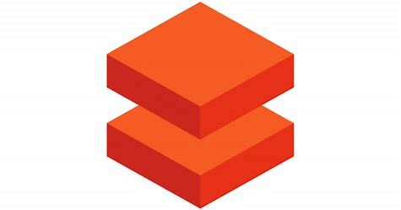

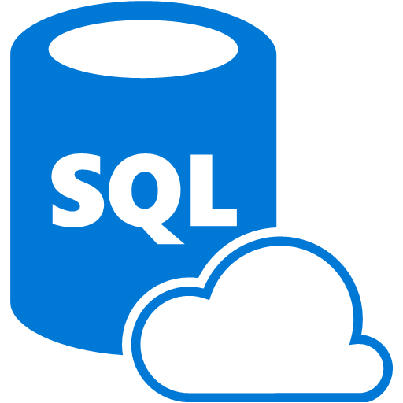
Azure Data Platform technologies
When you need a low cost, high throughput data store
When you need to store No-SQL data
When you do not need to query the data directly. No ad hoc query support
Suits the storage of archive or relatively static data
Suits acting as a HDInsight Hadoop data store
Storage Account
When you need a low cost, high throughput data store
Unlimited storage for No-SQL data
When you do not need to query the data directly. No ad hoc query support
Suits the storage of archive or relatively static data
Suits acting as a Databricks , HDInsight and IoT data store
Data Lake Store
Eases the deployment of a Spark based cluster
Enables the fastest processing of Machine Learning solutions
Enables collaboration between data engineers and data scientists
Provides tight enterprise security integration with Azure Active Directory
Integration with other Azure Services and Power BI
Azure Databricks
Provides global distribution for both structured and unstructured data stores
Millisecond query response time
99.999% availability of data
Worldwide elastic scale of both the storage and throughput
Multiple consistency levels to control data integrity with concurrency
Azure COSMOS DB
When you require a relational data store
When you need to manage transactional workloads
When you need to manage a high volume on inserts and reads
When you need a service that requires high concurrency
When you require a solution that can scale elastically
Azure SQL Database
Notes:
Taking points
This slide is optional and should be used at the trainer's discretion.
You may have students who have general question about the different technologies on Azure. This slide can be used to support answering such questions

Slide 19
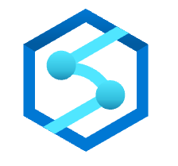




Azure Data Platform technologies (continued)
When you require an integrated relational and big data store
When you need to manage data warehouse and analytical workloads
When you need low cost storage
When you require the ability to pause and restart the compute
When you require a solution that can scale elastically
Azure Synapse
Analytics
When you require a fully managed event processing engine
When you require temporal analysis of streaming data
Support for analyzing IoT streaming data
Support for analyzing application data through Event Hubs
Ease of use with a Stream Analytics Query Language
Azure Stream Analytics
When you want to orchestrate the batch movement of data
When you want to connect to wide range of data platforms
When you want to transform or enrich the data in movement
When you want to integrate with SSIS packages
Enables verbose logging of data processing activities
Azure Data Factory
When you need a low cost, high throughput data store
When you need to store No-SQL data
Provides a Hadoop Platform as a Service approach
Suits acting as a Hadoop, Hbase, Storm or Kafka data store
Eases the deployment and management of clusters
Azure HDInsight
When you require documentation of your data stores
When you require a multi user approach to documentation
When you need to classify data sources
A fully managed cloud service whose users can discover the data sources
When you require a solution that can help any user understand their data
Azure Purview
Notes:
Talking points
This slide is optional and should be used at the trainer's discretion.
You may have students who have general question about the different technologies on Azure. This slide can be used to support answering such questions

Slide 20
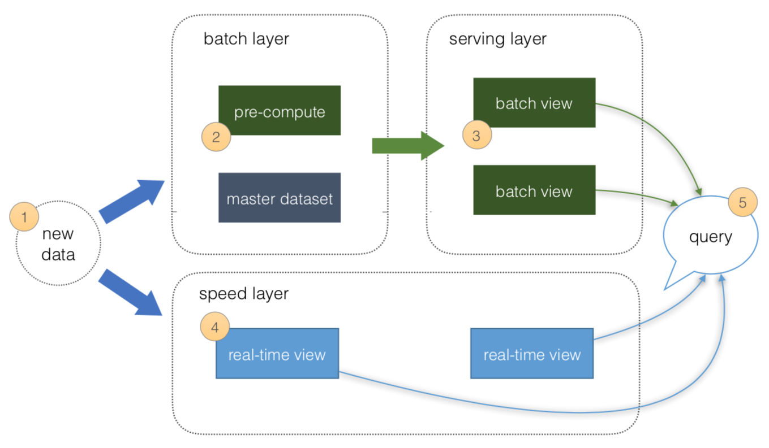
Lambda architectures
Batch Layer:
The Batch layer is used to pre-compute results on volumes of data using a distributed data system:
New data ingested from sources
Data is precomputed
Speed Layer:
The Speed layer processes data streams in near real time to minimize the latency of data ingestion:
New data ingested from sources
4. Real time views of the data created
Serving Layer:
The serving layer acts as the storage output of either the Batch or Speed layer used by client applications to access the results of the data-sets:
Batch views can be used as precomputed views
Notes:
Talking points
This slide is optional and should be used at the trainer's discretion.
You may have students who have questions about lambda architecture. This slide can be used to support answering such questions

